Slide 1
The Death and Burial of Jesus
Week 47

Slide 2
Weekend Information
Friday: Christ Tomb Tour
  Leave from Burns at 4:15
  Begins @ Woodlawn on Thompson Lane at 5:15
  Eat afterwards. Shoney’s or Rafferty’s?
  If interest – come back and watch The Gospel of John
Saturday: Singing at Casa de Hiatt
  Be at our house at 7pm
  Be full.
Sunday
  Fellowship Meal
  Walnut St. Thanks Singing 7pm

Slide 3
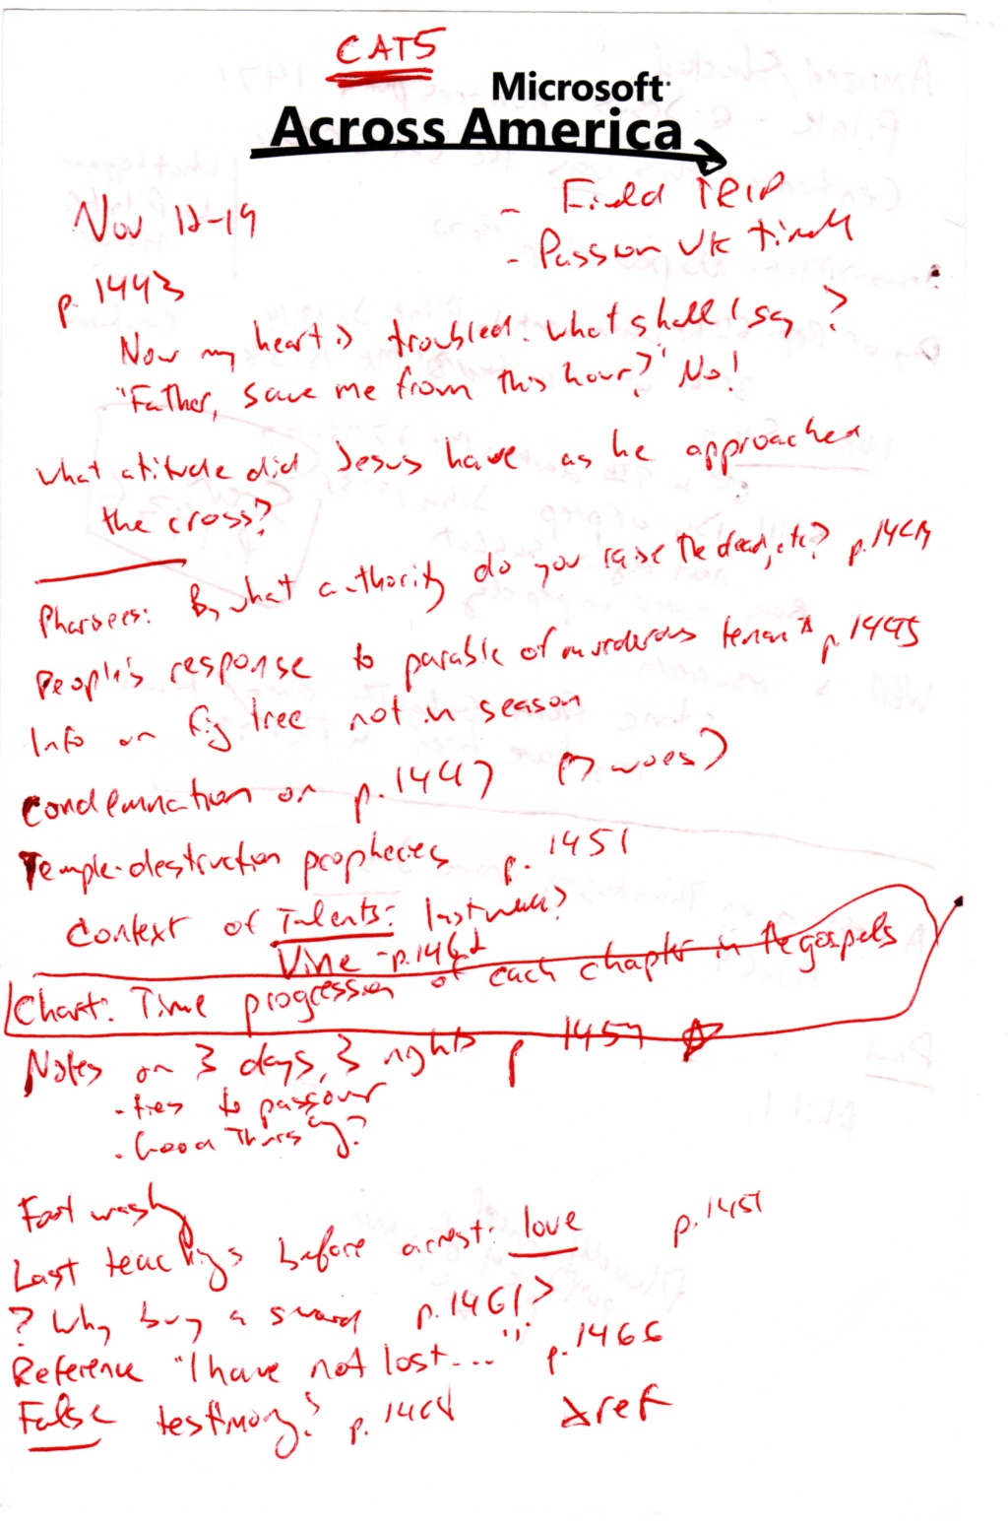
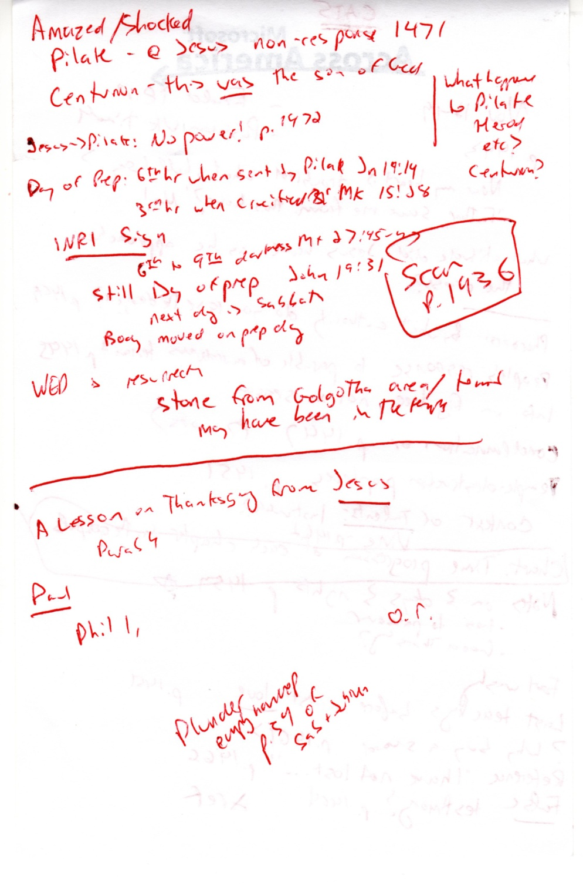

Slide 4
The death, burial, and resurrection of Jesus is THE central event of the Bible, history, and life.

Slide 5
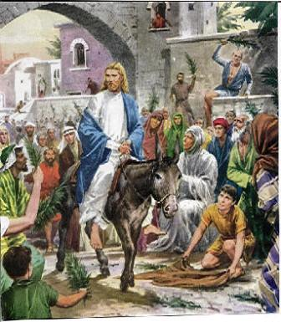

Slide 6
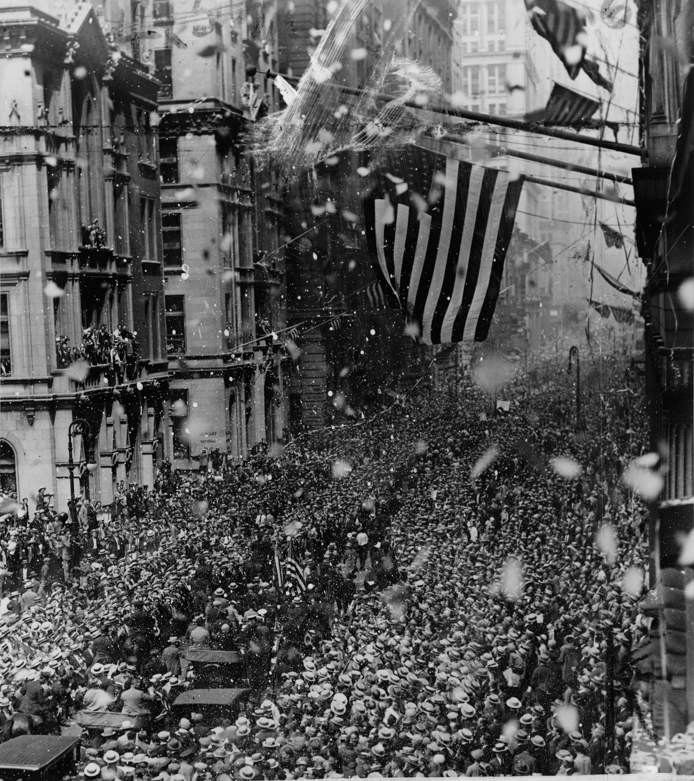

Slide 7
Structure and timeline of Mark’s Gospel
2 ½ years
6 months
1 week
Galilean Ministry
Perea
Judea
(Jerusalem)
Ministry begins. Opposition starts.
Opposition intensifies.
Trans-
ition
Υ
Holy Week
Chapters 1-9
Ch 10
Chs 11-16

Slide 8
Jesus’ Attitude Towards the Cross
Page 1443: “Now my heart is troubled. What shall I say? “Father, save me from this hour?” No! For this hour I have come…

Slide 9
Interesting Teachings in the Last Week
Dialogue with the Pharisees: How do you have permission to raise the dead? On the Sabbath!?! (1444)
The Parable of the Murderous Tenants (1445)
  Tuesday AM: The Crowd’s Response: “May it never be”
  Thursday PM: The Crowd’s Response: “Crucify Him!”
Jesus’ harshest condemnations of Pharisees etc
  “You’re wrong because you don’t know the Scriptures or the power of God!” (1446)
  The “Seven Woes” (1447-1448)
Jesus prediction of the temple destruction…and more? (1449-1453)

Slide 10
Fig Tree Cursing
“Not the season for figs”
  He saw that it had leaves.
  Mediterranean fig trees frequently bore the “pre-figs” before leaves flushed out.
  Therefore, if leaves were there, but no even unripe figs, there would be no figs that year at all.
This tree is FAKING having figs.

Slide 11
Jesus’ Perfect Example
Foot Washing
Forgiveness
No revile-ing in return
In his last hours, we get “A new command I give you: Love one another. As I have loved you, so you must love one another. By this will all men know that you are my disciples.”
Read John 13 through the end of the book.

Slide 12
Time Table of the Last Week
Generally believed Jesus died on Friday (day before the Sabbath.) See timeline on next slide.
F LaGard has an interesting theory on pp 1454-1455.
  Essentially, as part of Passover and Feast of Unleavened Bread, the day of Preparation of Passover was also a “Sabbath” type day.
  If that day didn’t fall on Saturday, there were two “Sabbaths” that week.

Slide 13
Day | Event | Biblical Reference
Sun | The triumphal entry into Jerusalem | Mark 11:1-11
Mon | Cleanses the temple in Jerusalem | Mark 11:15–19
Tues | The Sanhedrin challenges Jesus’ authority Jesus foretells the destruction of Jerusalem and His Second Coming Mary anoints Jesus at Bethany Judas bargains with the Jewish rulers to betray Jesus | Luke 20:1-8 Matt. 24; 25 John 12:2-8 Luke 22:3–6
Thurs | Jesus eats the Passover meal with His disciples and institutes the Memorial Supper Prays in Gethsemane for His disciples | John 13:1-30 Mark 14:22–26 John 17
Friday | His betrayal and arrest in the Garden of Gethsemane Jesus questioned by Annas, the former high priest Condemned by Caiaphas and the Sanhedrin Peter denies Jesus three times Jesus is formally condemned by the Sanhedrin Judas commits suicide The trial of Jesus before Pilate Jesus’ appearance before Herod Antipas Formally sentenced to death by Pilate Jesus is mocked and crucified between two thieves The veil of the temple is torn as Jesus dies His burial in the tomb of Joseph of Arimathea | Mark 14:43-50 John 18:12–24 Mark 14:53-65 John 18:15–27 Luke 22:66-71 Matt. 27:3–10 Luke 23:1-5 Luke 23:6–12 Luke 23:13-25 Mark 15:16–27 Matt. 27:51-56 John 19:31–42
Sunday | Jesus is raised from the dead | Luke 24:1–9
Thomas Nelson Publishers, Nelson's Complete Book of Bible Maps & Charts : Old and New Testaments., Rev. and updated ed. (Nashville, Tenn.: Thomas Nelson, 1996).

Slide 14
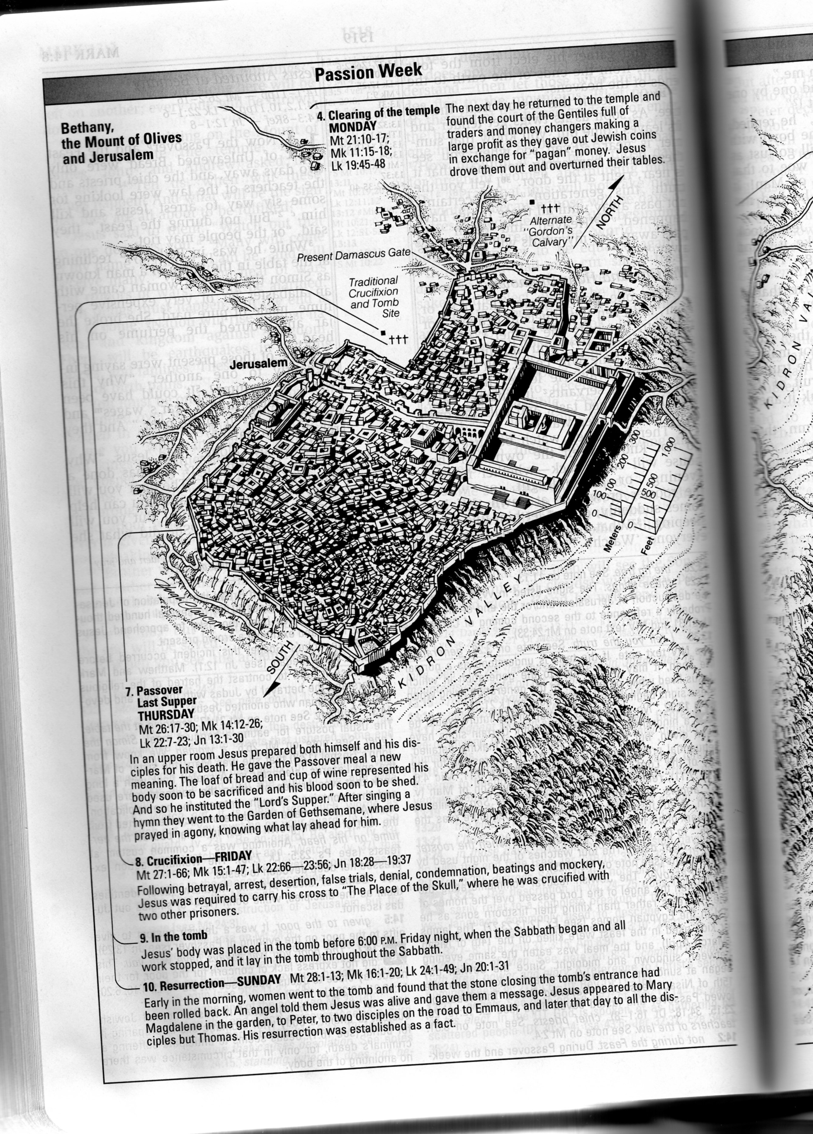
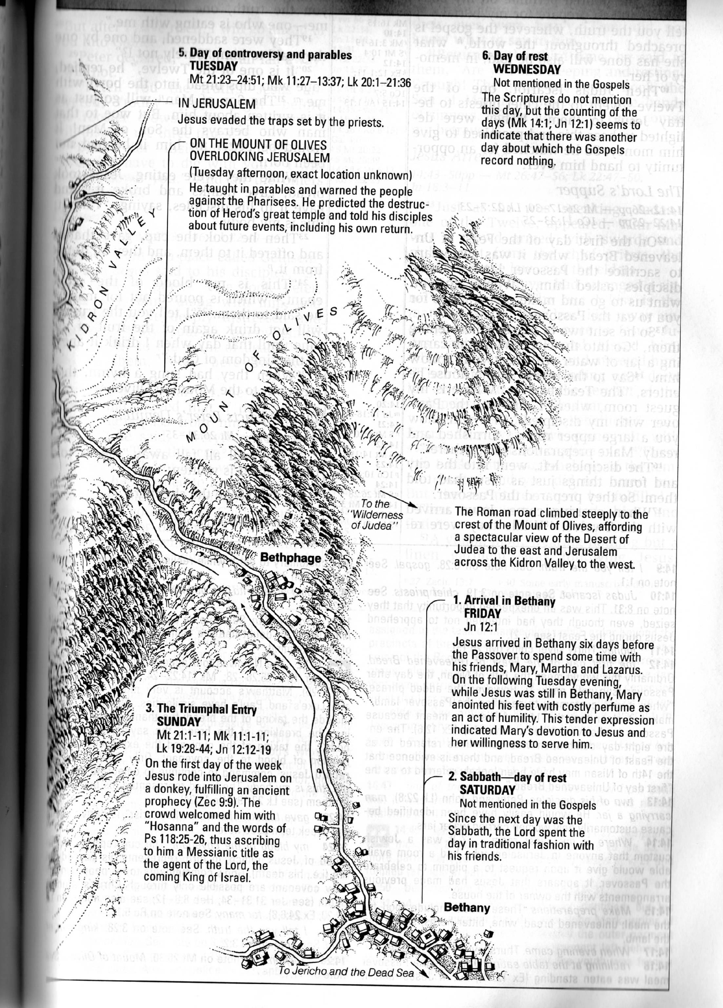
NIV Study Bible pp 1520-1521

Slide 15
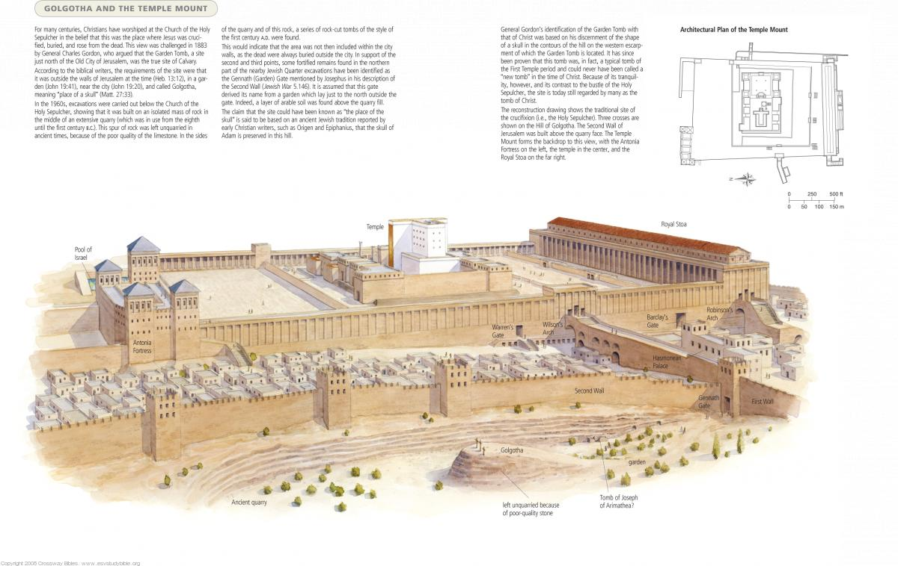

Slide 16
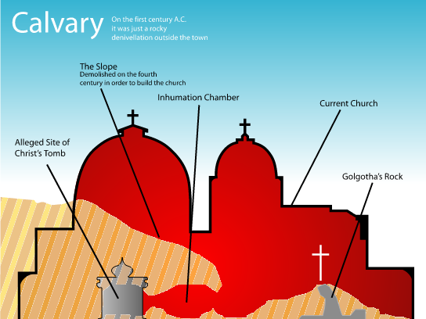
Church of the Holy Sepluchre

Slide 17
The Trials of Jesus (Jewish)
Preliminary Hearing before Annas (Jn 18:12-24)
  Annas questioned Jesus, but had no real authority.
Hearing before Caiphas (Matt 26:57-67; Mk 14:53-65)
  Caiaphas was the Roman-appointed HP. False witnesses testified, concluded Jesus was guilty of blasphemy
Trial before Sanhedrin (Matt 27:1-2, Mk 15:1, Lk 22:66-71)
  Council of religious leaders, Jesus admitted his Sonship.
Nelson Study Bible p 1804

Slide 18
The Trials of Jesus (Roman)
Pilate (Round 1): John 18:28-37, Mt 27:11-14, Mk 15:2-5, Lk 23:1-5
  Attempt to get Roman permission for execution.
  Pilate said he is innocent.
Herod (Lk 23:6-12)
  Sent by Pilate, since Herod was Galilean ruler.
  Jesus was silent and performed no “tricks”
Final Hearing with Pilate (Jn 18:38-19:16, Mt 27:15-26; Mk 15:6-15; Luke 23:13-25)
  Pilate didn’t want to risk an uprising. “Crucify him!”

Slide 19
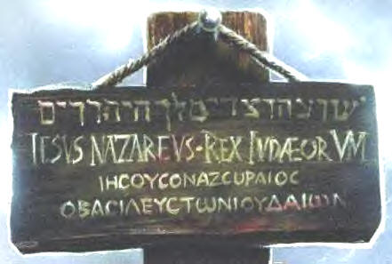
Notes:
שוע הנצרי ומלך היהודים
ιησους ο ναζωραιος ο βασιλευς των ιουδαιων
IESVS·NAZARENVS·REX·IVDÆORVM

Slide 20
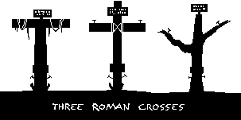

Slide 21
JAMA information

Slide 22
Prophecy

Slide 23
The Gory Details of Crucifixion

Slide 24
Seven Sayings of Jesus
Exercise: Put them in order yourselves.
Father, forgive them, for they know not what they do (Luke 23:34).
Truly, I say to you, today you will be with me in paradise (Luke 23:43).
Woman, behold your son: behold your mother (John 19:26-27).
Eli Eli lama sabachthani? ("My God, My God, why have you forsaken me?", Matthew 27:46 and Mark 15:34).
I thirst (John 19:28).
It is finished (John 19:30).
Father, into your hands I commit my spirit (Luke 23:46).
http://schaefer-family.com/sayings.htm

Slide 25
Phenomena of the Crucifixion
Temple Veil
Dead Raised
Eclipse
Earthquake
The Centurion’s Response

Slide 26
Earthquake
A prophecy in the Book of Amos predicts an earthquake during which the sun will set at midday:
  Shall not the land tremble on this account, and everyone mourn who lives in it, and all of it rise like the Nile, and be tossed about and sink again, like the Nile of Egypt? On that day, says the Lord God, I will make the sun go down at noon, and darken the earth in broad daylight. —Amos 8:8-9 (NRSV)
This was written during the reign of King Uzziah of Judah, seven centuries before Jesus. According to the beginning of the Book of Amos, an earthquake took place two years later; this was taken as a fulfillment of the prophecy. (Amos 1:1) The earthquake is referred to in the later Book of Zechariah (Zechariah 14:5), and archaeological evidence confirms it took place.[1]
The reference to darkness during daylight has been interpreted by some as a prophecy of the crucifixion darkness:[2][3]

Slide 27
Crucifixion Eclipse
In the biblical narrative, while Jesus is hanging on the cross, the sky is "darkened for 3 hours," from the sixth to the ninth hour (noon to mid-afternoon). Both Roman orator Julius Africanus and Christian theologian Origen refer to Greek historian Phlegon as having written "with regard to the eclipse in the time of Tiberius Caesar, in whose reign Jesus appears to have been crucified, and the great earthquakes which then took place"[66] Julius Africanus further refers to the writings of historian Thallus when ruling out the possibility of a solar eclipse: "This darkness Thallus, in the third book of his History, calls, as appears to me without reason, an eclipse of the sun. For the Hebrews celebrate the passover on the 14th day according to the moon, and the passion of our Saviour falls on the day before the passover; but an eclipse of the sun takes place only when the moon comes under the sun."[67] A solar eclipse concurrent with a full moon is a scientific impossibility. Diogenes is said to have commented "Either the Deity Himself suffers at this moment, or sympathizes with one who does."[68] Christian apologist Tertullian wrote "In the same hour, too, the light of day was withdrawn, when the sun at the very time was in his meridian blaze. Those who were not aware that this had been predicted about Christ, no doubt thought it an eclipse. You yourselves have the account of the world-portent still in your archives."[69]

Slide 28
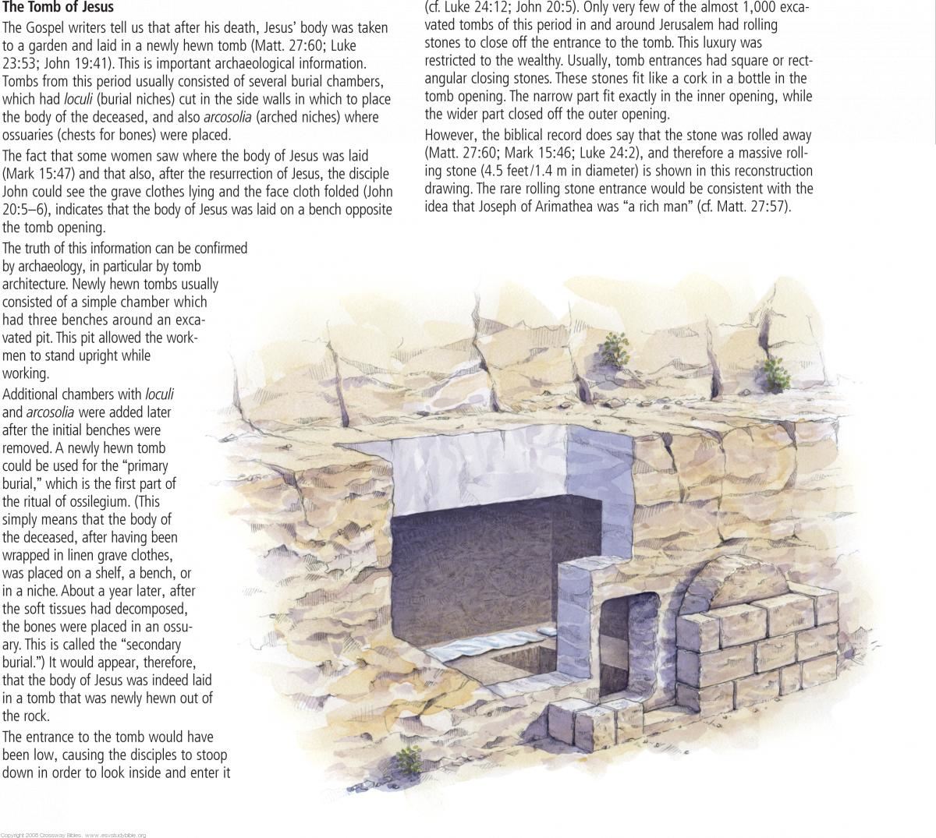

Slide 29
Why?

